Slide 1
Introducing ES6/ES2015
Tobias Hennig

Slide 2
About me
Twitter: @HennigTobias
GitHub: https://github.com/TobiasHennig
Visual Studio Code
Quokka (Live Feedback)
Dracula Theme

Slide 3
History
ES2016
veröffentlicht
„JavaScript“
vorgestellt
ECMAScript
Standard erstellt
ES5
veröffentlicht
ES2015
veröffentlicht
1996
1997
2009
2015
2016
Notes:
ES2015 - 17. Juni 2015
Yearly time-boxed release cycle

Slide 4
ES2015 Features
Better syntax
Arrows
Classes
Modules
Enhanced Object Literals
Template Strings
Destructuring
Default
Spread
...
New functionality
String and array methods
Let + Const
Promises
Maps, Sets
New features
Generators
Proxies
WeakMaps

Slide 5
Default
// ES5
function sayHi(name) {
var name = name || 'George';
alert('Hi ' + name);
}
// ES6
function sayHi(name = 'George') {
alert(`Hi ${name}`);
}

Slide 6
Template Strings
// ES5
var name = 'John';
alert('Hello ' + name);
// ES6
let name = John;
alert(`Hello + ${name}`);
Notes:
Multiline

Slide 7
var / let / const
[DEMO TIME]
Notes:
QUIZ
Hoisting
function-scoped -> block-scoped

Slide 8
Enhanced Object Literals
[DEMO TIME]
Notes:
Object/Method Shorthand

Slide 9
Destructuring
[DEMO TIME]

Slide 10
Rest / Spread
[DEMO TIME]

Slide 11
Classes
[DEMO TIME]
Notes:
https://addyosmani.com/resources/essentialjsdesignpatterns/book/#constructorpatternjavascript

Slide 12
Arrows
[DEMO TIME]

Slide 13
String methods
let name = 'Joe';
name.startsWith('J'); // true
name.endsWith('x'); // false
name.includes('o'); // true
name.repeat(3); // 'JoeJoeJoe'

Slide 14
Map
let items = new Map();
items.size;
items.set('key', 'value');
items.get('key');
items.has('key');
items.delete('key');
items.forEach((value, key) => console.log(value));
items.clear();

Slide 15
Set
const items = new Set(['one', 'two', 'three']);
items.add('two');
items.size; // 3
items.delete('two');
items.has('two');
items.forEach(item => alert(item));
items.clear();
Notes:
Set is a collection of unique elements

Slide 16
Promises
[DEMO TIME]

Slide 17
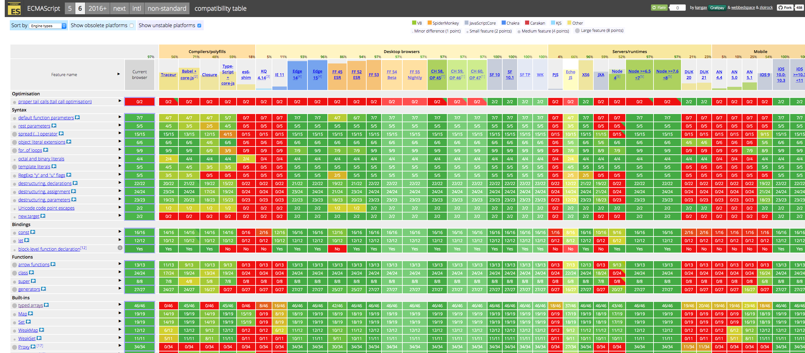
Compatibility

Slide 18


JavaScript Compiler
Babel
bublé
Presets
Plugins
De-facto standard
https://babeljs.io/
Quick
Simple
Good for small projects
https://buble.surge.sh

Slide 19
Modules
[DEMO TIME]

Slide 20


Module bundler
Webpack
Rollup
Complex
Plugins
Big community
https://babeljs.io/
Quick
Simple
Good for small projects
https://rollupjs.org

Slide 21
Learning Resources
Free Video Series - https://laracasts.com/series/es6-cliffsnotes
Free HTML-Book - http://exploringjs.com/es6/

